Slide 1
Unit-5: Memories and Programmable Logic
INTRODUCTION:
A memory unit is a device to which binary information is transferred for storage and from which information is retrieved when needed for processing. A memory unit is a collection of cells capable of storing a large quantity of binary information.
There are two types of memories that are used in digital systems: random‐access memory (RAM) and read‐only memory (ROM). RAM stores new information for later use. The process of storing new information into memory is referred to as a memory write operation. The process of transferring the stored information out of memory is referred to as a memory read operation. RAM can perform both write and read operations. ROM can perform only the read operation.

Slide 2
ROM is a programmable logic device (PLD). The binary information that is stored within such a device is specified in some fashion and then embedded within the hardware in a process is referred to as programming the device. ROM is one example of a PLD. Other such units are the programmable logic array (PLA), programmable array logic (PAL), and the field‐programmable gate array (FPGA).
Random Access Memory (RAM):
A memory unit stores binary information in groups of bits called words. A word in memory is an entity of bits that move in and out of storage as a unit. A memory word is a group of 1’s and 0’s and may represent a number, an instruction, one or more alphanumeric characters, or any other binary‐coded information. A group of 8 bits is called a byte . Most computer memories use words that are multiples of 8 bits in length.

Slide 3
The capacity of a memory unit is usually stated as the total number of bytes that the unit can store.
Communication between memory and its environment is achieved through data input and output lines, address selection lines, and control lines that specify the direction of transfer.
A block diagram of a memory unit is shown in Fig. 7.2 . The n data input lines provide the information to be stored in memory, and the n data output lines supply the information coming out of memory.
The k address lines specify the particular word chosen among the many available.
The two control inputs specify the direction of transfer desired: The Write input causes binary data to be transferred into the memory, and the Read input causes binary data to be transferred out of memory.

Slide 4
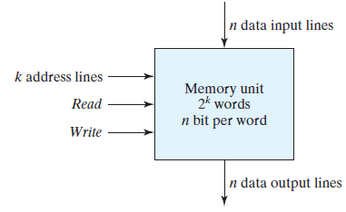
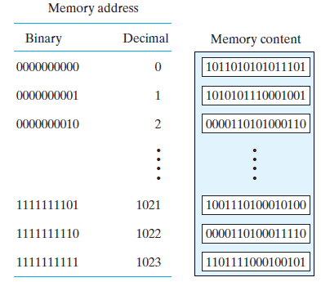
FIGURE 7.2 Block diagram of a memory unit
FIGURE 7.3 Contents of a 1024 * 16 memory

Slide 5
The memory unit is specified by the number of words it contains and the number of bits in each word.
The address lines select one particular word. Each word in memory is assigned an identification number, called an address, starting from 0 up to 2^k - 1, where k is the number of address lines.
The selection of a specific word inside memory is done by applying the k ‐bit address to the address lines. An internal decoder accepts this address and opens the paths needed to select the word specified.
Memories vary greatly in size and may range from 1,024 words, requiring an address of 10 bits, to 2^32 words, requiring 32 address bits.
Consider, for example, a memory unit with a capacity of 1K words of 16 bits each. Since 1K = 1,024 = 2^10 and 16 bits constitute two bytes, we can say that the memory can accommodate 2,048 = 2K bytes.

Slide 6
The 1K x 16 memory of Fig. 7.3 has 10 bits in the address and 16 bits in each word.
As another example, a 64K x 10 memory will have 16 bits in the address (since 64K = 2^16 ) and each word will consist of 10 bits.
The number of address bits needed in a memory is dependent on the total number of words that can be stored in the memory and is independent of the number of bits in each word.
The number of bits in the address is determined from the relationship
where m is the total number of words and k is the number of address bits needed to satisfy the relationship.

Slide 7
Write and Read Operations:
The two operations that RAM can perform are the write and read operations.
On accepting one of these control signals, the internal circuits inside the memory provide the desired operation.
The steps that must be taken for the purpose of transferring a new word to be stored into memory (i.e. write) are as follows:
1. Apply the binary address of the desired word to the address lines.
2. Apply the data bits that must be stored in memory to the data input lines.
3. Activate the write input.
The memory unit will then take the bits from the input data lines and store them in the word specified by the address lines.

Slide 8
The steps that must be taken for the purpose of transferring a stored word out of memory (i.e. read) are as follows:
1. Apply the binary address of the desired word to the address lines.
2. Activate the read input.
The memory unit will then take the bits from the word that has been selected by the address and apply them to the output data lines. The contents of the selected word do not change after the read operation, i.e., the word operation is nondestructive.
Instead of having separate read and write inputs to control the two operations, most integrated circuits (ICs) provide two other control inputs: One input selects the unit and the other determines the operation. The memory operations that result from these control inputs are specified in Table 7.1 .

Slide 9
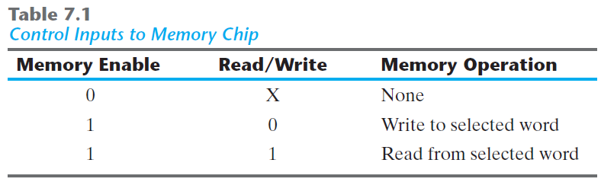
The memory enable (sometimes called the chip select) is used to enable the particular memory chip in a multichip implementation of a large memory.
When the memory enable is inactive, the memory chip is not selected and no operation is performed. When the memory enable input is active, the read/write input determines the operation to be performed.

Slide 10
Memory Description in HDL:
Memory is modeled in the Verilog hardware description language (HDL) by an array of registers. It is declared with a reg keyword, using a two‐dimensional array. The first number in the array specifies the number of bits in a word (the word length ) and the second gives the number of words in memory (memory depth ). For example, a memory of 1,024 words with 16 bits per word is declared as
reg [15: 0] memword [0: 1023];
This statement describes a two‐dimensional array of 1,024 registers, each containing 16 bits.
The second array range in the declaration of memword specifies the total number of words in memory and is equivalent to the address of the memory. For example, memword[512] refers to the 16‐bit memory word at address 512.

Slide 11
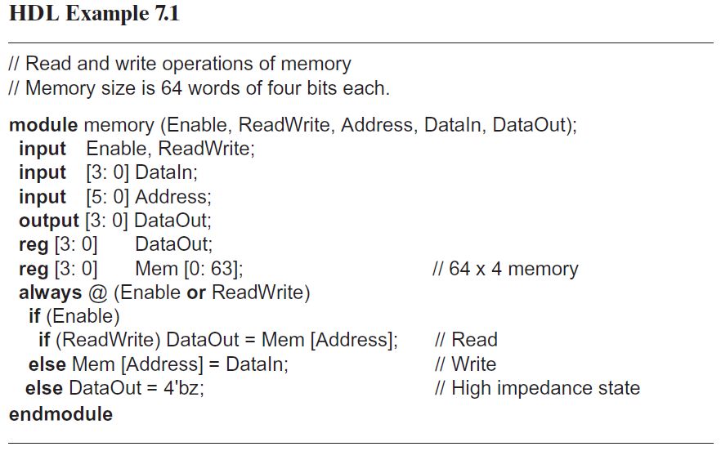

Slide 12
Timing Waveforms:
The operation of the memory unit is controlled by an external device such as a central processing unit (CPU). The CPU is usually synchronized by its own clock.
The memory, however, does not employ an internal clock. Instead, its read and write operations are specified by control inputs.
The access time of memory is the time required to select a word and read it.
The cycle time of memory is the time required to complete a write operation.
The CPU must provide the memory control signals in such a way as to synchronize its internal clocked operations with the read and write operations of memory.
This means that the access time and cycle time of the memory must be within a time equal to a fixed number of CPU clock cycles.

Slide 13
Suppose as an example that a CPU operates with a clock frequency of 50 MHz, giving a period of 20 ns for one clock cycle.
Suppose also that the CPU communicates with a memory whose access time and cycle time do not exceed 50 ns. Since the period of the CPU cycle is 20 ns, it will be necessary to devote at least two‐and‐a‐half, and possibly three, clock cycles for each memory request.
The write cycle in part (a) shows three 20‐ns cycles: T1, T2, and T3.
For a write operation, the CPU must provide the address and input data to the memory. This is done at the beginning of T1.
The memory enable and the read/write signals must be activated after the signals in the address lines are stable.
The address and data signals must remain stable for a short time after the control signals are deactivated.

Slide 14
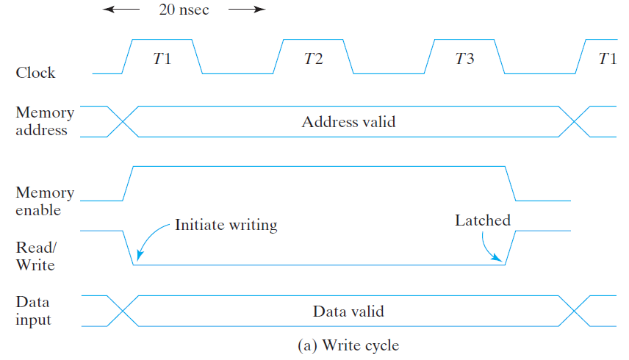

Slide 15
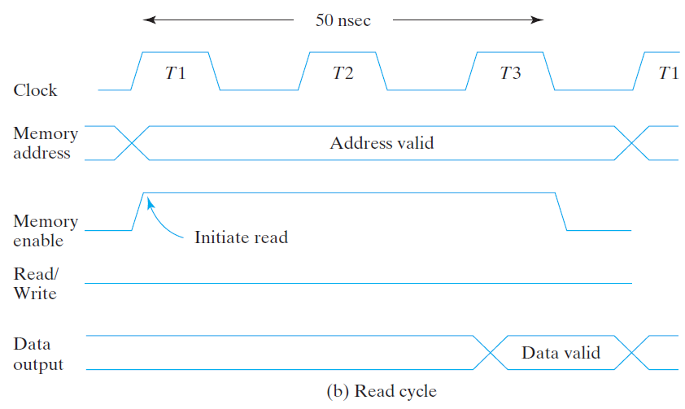

Slide 16
Types of Memories
Integrated circuit RAM units are available in two operating modes: static and dynamic.
Static RAM (SRAM) consists essentially of internal latches that store the binary information. The stored information remains valid as long as power is applied to the unit.
Dynamic RAM (DRAM) stores the binary information in the form of electric charges on capacitors provided inside the chip by MOS transistors.
The stored charge on the capacitors tends to discharge with time, and the capacitors must be periodically recharged by refreshing the dynamic memory.
Refreshing is done by cycling through the words every few milliseconds to restore the decaying charge.
DRAM offers reduced power consumption and larger storage capacity in a single memory chip.
SRAM is easier to use and has shorter read and write cycles.

Slide 17
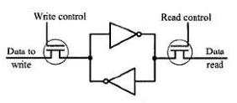
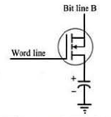
Visualisation of Static RAM (SRAM):
Dynamic RAM (DRAM):

Slide 18
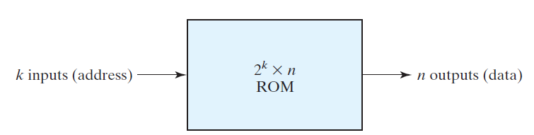
READ‐ONLY MEMORY
A read‐only memory (ROM) is essentially a memory device in which permanent binary information is stored.
The binary information must be specified by the designer and is then embedded in the unit to form the required interconnection pattern.
Once the pattern is established, it stays within the unit even when power is turned off and on again.
Note that ROM does not have data inputs, because it does not have a write operation.

Slide 19
Consider, for example, a 32 X 8 ROM. The unit consists of 32 words of 8 bits each.
There are five input lines that form the binary numbers from 0 through 31 for the address.
Figure 7.10 shows the internal logic construction of this ROM.
The five inputs are decoded into 32 distinct outputs by means of a 5 X 32 decoder.
Each output of the decoder represents a memory address. The 32 outputs of the decoder are connected to each of the eight OR gates.
Each OR gate must be considered as having 32 inputs. Each output of the decoder is connected to one of the inputs of each OR gate.
Since each OR gate has 32 input connections and there are 8 OR gates, the ROM contains 32 X 8 = 256 internal connections.
In general, a 2^k X n ROM will have an internal k X 2^k decoder and n OR gates.

Slide 20
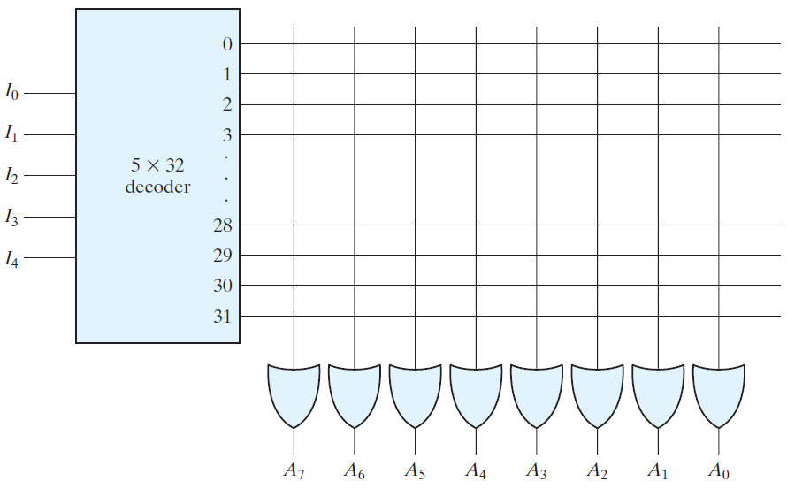
Each OR gate has 2^k inputs, which are connected to each of the outputs of the decoder.
FIGURE 7.10 Internal logic of a 32 x 8 ROM

Slide 21
The 256 intersections in Fig. 7.10 are programmable. A programmable connection between two lines is logically equivalent to a switch that can be altered to be either closed (meaning that the two lines are connected) or open (meaning that the two lines are disconnected).
The programmable intersection between two lines is sometimes called a crosspoint.
Various physical devices are used to implement crosspoint switches.
One of the simplest technologies employs a fuse that normally connects the two points, but is opened or “blown” by the application of a high‐voltage pulse into the fuse.

Slide 22
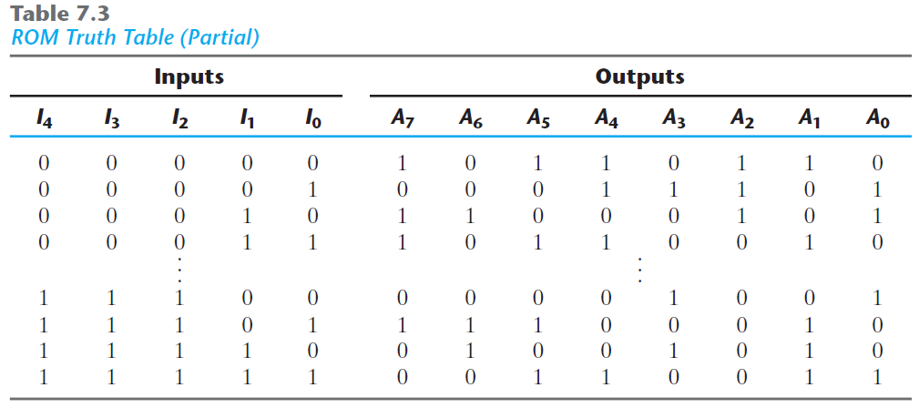

Slide 23
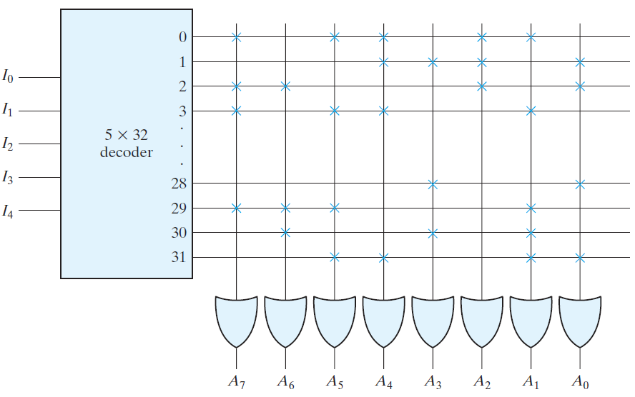
FIGURE 7.11: Programming the ROM according to Table 7.3

Slide 24
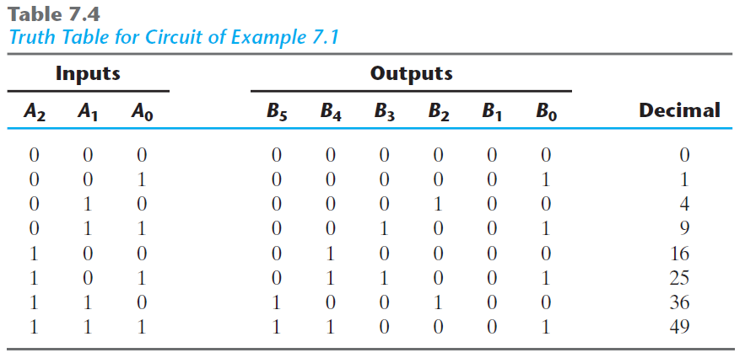
Combinational Circuit Implementation
Design a combinational circuit using a ROM. The circuit accepts a three‐bit number and outputs a binary number equal to the square of the input number.

Slide 25
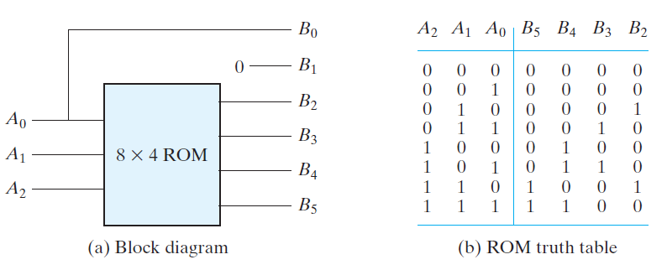
Types of ROMs:
MROM
PROM
EPROM
EEPROM
FLASH MEMORY

Slide 26
Combinational PLDs
The PROM is a combinational programmable logic device (PLD)—an integrated circuit with programmable gates divided into an AND array and an OR array to provide an AND–OR sum‐of‐product implementation. There are three major types of combinational PLDs, differing in the placement of the programmable connections in the AND–OR array. Figure 7.13 shows the configuration of the three PLDs. The PROM has a fixed AND array constructed as a decoder and a programmable OR array. The programmable OR gates implement the Boolean functions in sum‐of‐minterms form. The PAL has a programmable AND array and a fixed OR array. The most flexible PLD is the PLA, in which both the AND and OR arrays can be programmed. The names PAL and PLA emerged from different vendors during the development of PLDs.

Slide 27
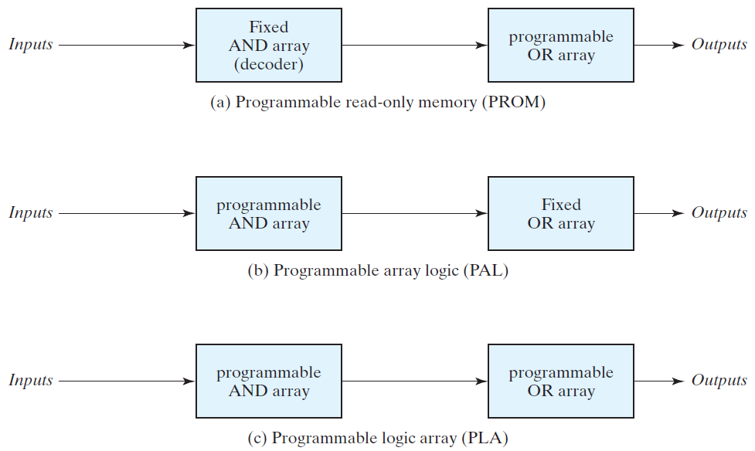
FIGURE 7.13: Basic configuration of three PLDs

Slide 28
PROGRAMMABLE LOGIC ARRAY:
The PLA is similar in concept to the PROM, except that the PLA does not provide full decoding of the variables and does not generate all the minterms. The decoder is replaced by an array of AND gates that can be programmed to generate any product term of the input variables. The product terms are then connected to OR gates to provide the sum of products for the required Boolean functions. The internal logic of a PLA with three inputs and two outputs is shown in Fig. 7.14 . Such a circuit is too small to be useful commercially, but is presented here to demonstrate the typical logic configuration of a PLA.

Slide 29
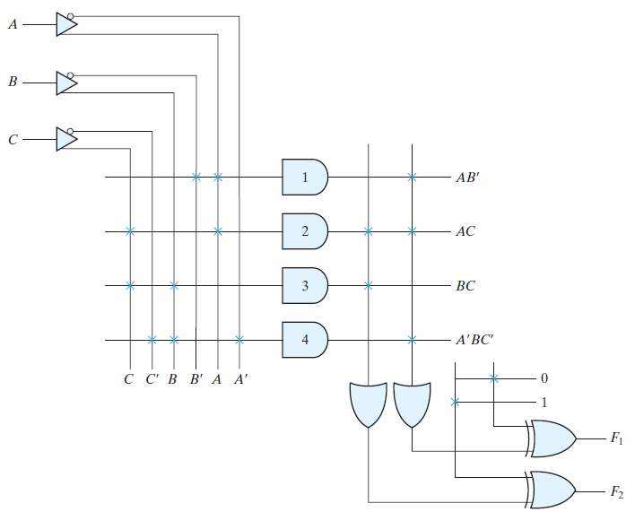
FIGURE 7.14: PLA with three inputs, four product terms, and two outputs

Slide 30
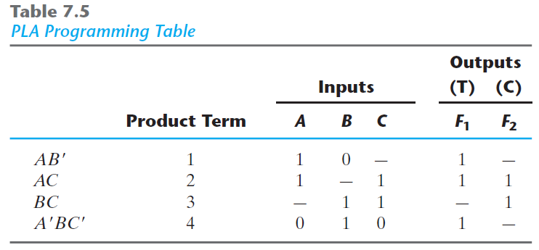

Slide 31
The size of a PLA is specified by the number of inputs, the number of product terms, and the number of outputs. A typical integrated circuit PLA may have 16 inputs, 48 product terms, and eight outputs. For n inputs, k product terms, and m outputs, the internal logic of the PLA consists of n buffer–inverter gates, k AND gates, m OR gates, and m XOR gates. There are 2n * k connections between the inputs and the AND array, k * m connections between the AND and OR arrays, and m connections associated with the XOR gates.
With reference to previous example: n = 3, k = 4, m=2.

Slide 32

Points to remember:
In implementing a combinational circuit with a PLA, careful investigation must be undertaken in order to reduce the number of distinct product terms, since a PLA has a finite number of AND gates. This can be done by simplifying each Boolean function to a minimum number of terms.
Both the true value and the complement of each function should be simplified to see which one can be expressed with fewer product terms and which one provides product terms that are common to other functions.
Example:
Implement the following two Boolean functions with a PLA:

